Slide 1
Agenda Item 5 –
7 LBS STAC Recommendations
UNEP(DEPI)/CAR WG.46/5 and Actions Taken
Photo courtesy of the Cartagena Convention Secretariat

Slide 2
7 LBS STAC RECOMMENDATION I
REQUESTS FOR INPUT INTO DRAFT WORK PLAN
Contracting Parties submit any written comments on the 2026-2027 Draft AMEP and LBS RAC Workplans to the Secretariat no later than 08 August 2025, to enable an updated draft Work Plan and Budget to be submitted to the 7th LBS COP for further review and approval.
The Secretariat convene a virtual Pre-Cartagena Convention COP to review and further revise the Sargassum Action Plan and RAC/RAN Guidelines for consideration by COP18, as appropriate.

Slide 3

Summary of Pre-COP Discussion on RAC/RAN Guidelines
UNEP(DEPI)_CAR IG 49_CRP 1

Slide 4
Context
13 SPAW and 7 LBS STACs recommended that the RAC/RAN guidelines be further reviewed during a Pre-COP
Pre-COP convened 17 and 18 September 2025
The following document was reviewed and discussed during the meeting UNEP(DEC)/CAR.IG.24/CRP.9 Rev 4 – Updated Guidelines for the Establishment and Operation of RACs and RANs
Pre-COP served as an informal forum for delegates to express concerns, clarify issues, and propose edits to the document

Slide 5
AMEP Sub Programme Regional Activity Centres
LBS Protocol
  Centro de Investigación y Manejo Ambiental del Transporte (CIMAB) - Cuba
  Institute of Marine Affairs (IMA) – Trinidad and Tobago
Oil Spills Protocol
  Regional Marine Pollution Emergency, Information and Training Centre – Caribe (REMPEITC – Caribe) – (Awaiting new home)
Example of an LBS RAN
  Gulf Caribbean Fisheries Institute (GCFI)
Updated RAC/RAN guidelines are important to the continued work of the RACs and RANs

Slide 6

Approach
Five thematic sections of the RACs/RANs Guidelines were presented and discussed:
Purpose
Objectives
Functions
Process for Designating or Redefining RACs/RANs
Functioning

Slide 7

Summary of Discussions
General
Need to clearly define the strategic objectives and functions
Overlap and repetition in many sections
Use of language that appears to be legally binding
Regional Activity Centres
Functions should focus on specific activities that RACs are expected to undertake
Proposals for new RACs should be assessed based on their alignment with defined objectives and functions.
Clarification is needed on who should submit proposals (governments or institutions).
Communication procedures and processes with National Focal Points require clarification.
Regional Activity Network
Clarification on the term RAN, RANs and RAN Organization
Clear definition of COP responsibility versus that of the Secretariat in the work of the RACs and RANs

Slide 8
Proposed 7 LBS COP Decision
Contracting Parties may wish to:
Request the Secretariat provide an updated version of the RAC/RAN Guidelines.
Request that an inter-sessional Convention Working Group be established to finalize the revision of the RAC/RAN Guidelines
Request the Secretariat share the final version of the RAC/RAN Guidelines inter-sessionally for final review and endorsement

Slide 9
7 LBS STAC RECOMMENDATION II
WORKPLAN
Contracting Parties and the Secretariat continue to explore capacity development opportunities with various partners including private sector, industry and development banks, the International Atomic Energy Agency (IAEA), and Research Network of Marine-Coastal Stressors in Latin America and the Caribbean (REMARCO) and encourage a continued partnership approach to facilitate work plan implementation building on expanding the Regional Activity Network (RAN).
Contracting Parties encourage continued efforts to integrate activities under the AMEP and SPAW Work Programmes including on the management of Sargassum inundations and the development of an integrated State of Convention Area Reports on Marine Pollution and Marine Habitats in collaboration between RACs and Working Groups, and in the development of new project proposals.
The Secretariat continue to work with the LBS RACs to provide regional training for ongoing and new projects within their technical areas of competence.

Slide 10
7 LBS STAC RECOMMENDATION III
LBS PROTOCOL RATIFICATION
Contracting Parties welcome the Government of Saint Kitts and Nevis as the Sixteenth Contracting Party to the LBS Protocol and encourage countries that have not yet done so to become party to the LBS Protocol.
Contracting Parties recognize efforts by Non-Contracting Parties to the LBS Protocol to become Contracting Parties and acknowledge the ongoing efforts by the Secretariat and the RACs to provide support to Non-Contracting Parties to ratify the LBS Protocol.

Slide 11
7 LBS STAC RECOMMENDATION IV
SOURCES AND IMPACTS OF MARINE POLLUTION
Nutrient and Wastewater Pollution
The Secretariat, with support of the LBS RACs and the OEWG and its thematic sub-groups, continue to support the implementation of the regional nutrient pollution reduction strategy and action plan in countries of the Wider Caribbean Region at national and regional levels while noting that existing proposed timelines may require adjustment.
Contracting Parties are encouraged to continue reviewing the proposed nutrients parameters and limits of discharges as outlined in UNEP(DEPI)/CAR WG.44/INF.17 Rev.1, with relevant stakeholders at the national level, as appropriate.
Contracting Parties continue discussions on the issue of nutrient parameters and limits of discharges as part of the Nutrients and Wastewater Thematic Subgroup of the OEWG which should:
  review and assess proposed parameters and limits for domestic wastewater
  identify different ways of establishing discharge limits for industrial effluent
Contracting Parties that have not yet done so, are encouraged to monitor and assess wastewater discharges to establish baselines and develop separate national discharge standards for industrial effluent to facilitate improved management of coastal and marine waters.

Slide 12
7 LBS STAC RECOMMENDATION IV
SOURCES AND IMPACTS OF MARINE POLLUTION
Water Classification
Contracting Parties continue discussions on the proposed guidelines for classifying waters according to the LBS Protocol as defined under UNEP(DEPI)/CAR WG.44/INF.16 Rev.1 to further inform the classification process for marine, coastal and estuarine waters.
Contracting Parties request that the LBS RACs, with support of the Secretariat and LBS OEWG, develop recommendation(s) for consideration by the Contracting Parties at the LBS COP7 to conduct further studies on the effectiveness of regulatory implementation of national marine, coastal and estuarine water classification schemes, including gathering information as to how such water bodies are delineated and aligned to the LBS Protocol, subject to the availability of funding.
Contracting Parties request that the Open-Ended Working Group, including LBS RACs, continue discussions on the draft proposed guidelines for the classification of waters and the scope of the types of waters to be studied within the Convention area, and identify best practices for consideration at the LBS STAC8 and COP8.

Slide 13

RECOMMENDATIONS FOR CONDUCTING FURTHER STUDIES ON THE EFFECTIVENESS OF REGULATORY IMPLEMENTATION OF NATIONAL MARINE, COASTAL AND ESTUARINE WATER CLASSIFICATION SCHEMES AND DELINEATION OF WATER BODIES ALIGNED TO THE LBS PROTOCOL
UNEP(DEPI)/CAR IG.50/INF.3

Slide 14
Proposed Approach
Scope of work
  Studies could assess and document the effectiveness of national marine, coastal, and estuarine water classification schemes, with a focus on their regulatory implementation and alignment with the LBS Protocol.
Lead responsibility
  Work advanced through the LBS RACs with the assistance of the OEWG, particularly the Nutrients and Wastewater subgroup.
Dependent on availability of resources

Slide 15
Possible Approach to Study
Proposed objective
  Seek to generate a detailed, practice-oriented understanding of how selected Contracting Parties delineate and manage classified water bodies
Proposed activities
  Identify target countries
  Conduct bilateral consultations to understand institutional arrangements and any barriers
  Document methodologies used by selected countries
  Undertake field missions
  Synthesis results and document best practices

Slide 16
Output of Study
A consolidated technical report presenting:
  Country case studies of effective classification systems.
  Analysis of barriers and enabling factors.
  Documented methodologies for delineation and classification.
  Practical recommendations feeding into the Draft Guidelines for the Classification of Waters (Part 3, Recommendation IV) for consideration at LBS STAC8 and COP8.

Slide 17
Proposed 7 LBS COP Decision
Contracting Parties may wish to:
Request the Secretariat, dependent on the availability of resources advance a study to assess and document the effectiveness of national marine, coastal, and estuarine water classification schemes, with a focus on regulatory implementation and alignment with the LBS Protocol.
Request the Secretariat present the findings and recommendations to LBS STAC8 and COP8 for consideration.

Slide 18
7 LBS STAC RECOMMENDATION V
MONITORING AND ASSESSMENT
Contracting Parties endorse the revised Terms of Reference of the Open-Ended Working Group for Monitoring and Assessment and Subgroups.
Contingent on decisions taken by the LBS COP and Convention COP, Contracting Parties request the Cartagena Convention COP invite members of the Open-Ended Working Group (OEWG) to contribute to the development of the integrated State of Convention Area Reports on Marine Pollution and Marine Habitats, in collaboration with the SPAW Subprogramme. The Working Group could be responsible for:
    defining the scope and objective of the report;
    undertaking a review of possible harmonised regional monitoring guidelines and analysis of the primary and optimal pollution parameters to be used in the development of the second State of Convention Area report to allow for data compatibility; and
    reviewing and providing revisions to draft versions of the report.
The Secretariat provide additional information to LBS COP7, SPAW COP 13 and IGM/COP 18 regarding how an integrated State of Convention Area Report (SOCAR) on marine pollution and marine habitats could be developed, including possible engagement with the State of Marine Ecosystems and Economies (SOMEE) Working Group and other experts, where appropriate and within the scope of the Convention.

Slide 19
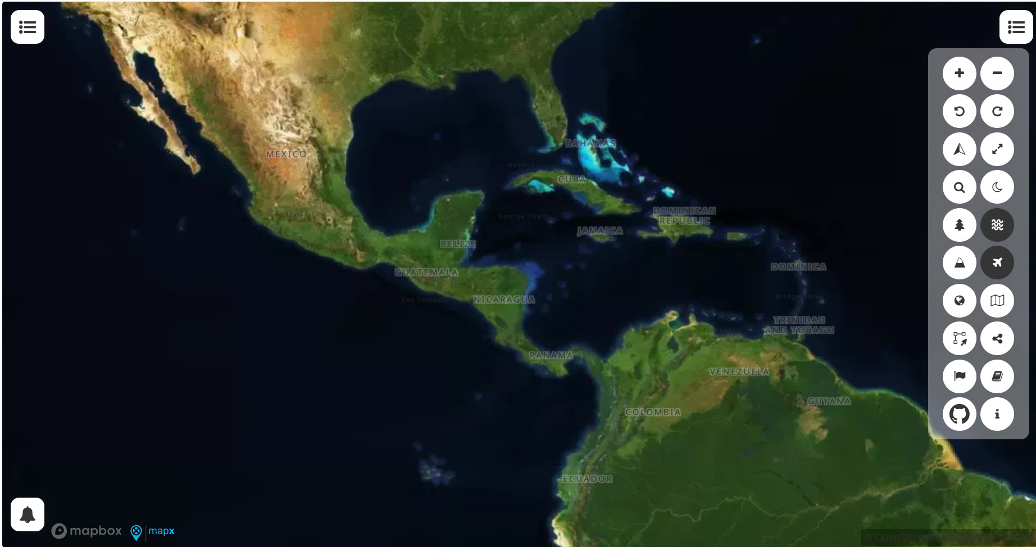
Towards an integrated State of Convention Area Report on marine pollution and marine habitats
UNEP(DEPI)_CAR IG 49_INF 5

Slide 20
Context
Reporting Requirements under the Cartagena Convention and its Protocols
  Article 16(2)(a) of the Convention calls on Contracting Parties to periodically assess the state of the environment within the Convention Area.
  Article 12 of the LBS Protocol requires Contracting Parties to submit reports to the Secretariat containing information on the environmental status of the Convention Area

Slide 21
Context
1 LBS COP, Decision 3 expanded the mandate of the Interim Working Group on environmental monitoring and assessment to work on the development of SOCAR
Support provided by CLME+ and CReW+ Projects in the development of the SOCAR and State of Habitats Report
Reports demonstrated clear linkages between land-based sources of pollution and the health of coral reefs, mangrove & sea grass beds
SOMEE to be defined by the PROCARIBE+ Ocean Coordination Mechanism
SOMEE to focus on three transboundary issues -marine pollution, habitat degradation, and unsustainable fisheries – of socio-economic importance to key marine sectors.
15th Cartagena Convention COP, decision 3 new Open-Ended Working Group (OEWG) on Monitoring and Assessment to support the LBS Protocol and SOCAR development established

Slide 22
Towards an integrated SOCAR
That the OEWG on Monitoring and Assessment establish a sub-group to support the development of the integrated SOCAR on marine pollution and marine habitats
  Open to all Contracting Parties from the Convention and its protocols
  Have representation from both the LBS and SPAW RACs and RANs, and regional experts
  Ensure that biodiversity conservation and pollution reduction are treated as equally weighted pillars of the integrated SOCAR

Slide 23
Potential mandate of the integrated SOCAR sub-group
Define the objectives and scope of the integrated SOCAR.
Discuss and agree on the methodological framework to be utilized for the integrated SOCAR.
Review the recommendations of the focused subgroups.
Ensure alignment with SOMEE’s methodological framework.
Meet regularly to monitor progress and review SOCAR draft content.

Slide 24
Establishing other subgroups
A Pollution Data Subgroup to guide data analysis for SOCAR under the OEWG.
A SPAW Subgroup to identify and assess key marine habitats and their ecological status.
Subgroups could jointly propose a minimum set of core indicators for pollution and biodiversity/ecosystem health to ensure comparability and regional consistency

Slide 25

How SOCAR can feed into other regional and global assessments
State of Marine Ecosystems and associated socio-Economies (SOMEE)
  Previous COP decisions requesting greater integration between SOCAR and SOMEE
  Secretariat is exploring opportunities for engaging with the SOMEE development process under the Ocean Coordination Mechanism (OCM)
  Participation of SOMEE Working Group representative in the integrated subgroup and participation of SOCAR subgroup lead in SOMEE WG

Slide 26
Proposed 7 LBS COP Decision - SOCAR
Contracting Parties may wish to
Request COP 18 to endorse the establishment of an OEWG sub-group to support the development of the integrated State of Convention Area report on marine pollution and marine habitats.
Request that the proposed sub-group be open to all Contracting Parties from the Cartagena Convention and its protocols and regional experts, as necessary.
Encourage Contracting Parties to submit the requested data and information to be used to inform the integrated SOCAR on marine pollution and marine habitats.
Request the Secretariat identify potential partner organizations that could provide supplementary data on coastal water quality to inform the integrated SOCAR.

Slide 27
7 LBS STAC RECOMMENDATION V
MONITORING AND ASSESSMENT
Contracting Parties consider Recommendation V on Sargassum of the SPAW STAC11 Meeting at the LBS COP7 and IGM21/COP18.
SPAW STAC11
RECOMMENDATION V SARGASSUM
1. The Secretariat and/or SPAW-RAC, as appropriate, invite Contracting Parties to provide comments on the “STAC Sargassum Working Group Updated Action Plan Proposal and Sustainable Financing Resources” (UNEP(DEPI)/CAR WG.45/INF.27) by 21 July 2025, ensuring that all feedback is transparently reviewed and effectively integrated, and call for an intersessional meeting, if needed, and the Secretariat provide interpretation depending on availability of funds.
2. The Sargassum Working Group be at the level of the Convention Parties to facilitate participation by both the SPAW and LBS Protocols.
3. The Secretariat provide additional information to SPAW COP13, LBS COP7 and IGM21/COP18 regarding how an integrated State of the Convention Area Report could be developed, beginning with a dedicated chapter on Sargassum. The terms of reference of this report should include:
• The proposed institutional mechanisms and coordination processes required for its development;
• The roles and responsibilities of relevant stakeholders;
• A suggested timeline and methodology for compiling and validating the report; and
• The process for presenting the final report to the Contracting Parties for review and endorsement.
4. The Secretariat provide additional information regarding how a Convention-level working group on Sargassum could operate, including how it could be tasked and how any products it may develop could be considered by the governing bodies of the Cartagena Convention and its Protocols.

Slide 28
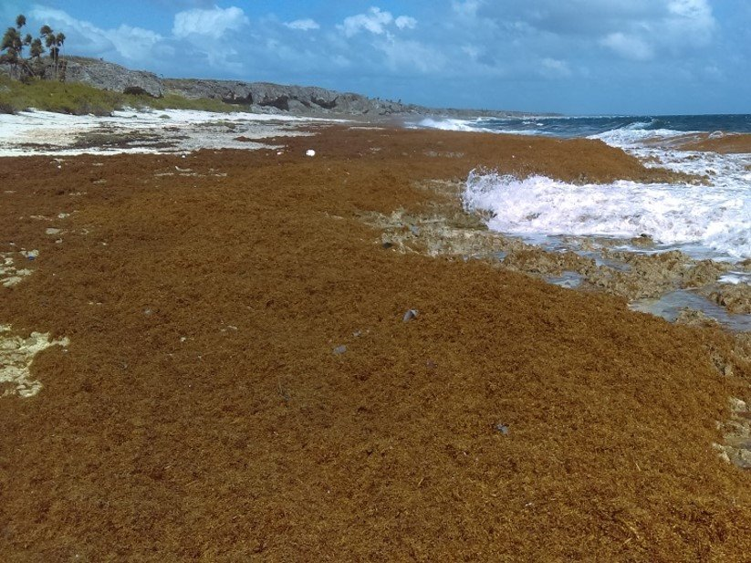
Sargassum
Cartagena Action Plan on Sargassum
  OEWG contributed to its development
  Revised Cartagena Action Plan on Sargassum Inundation discussed during Pre-COP
  Additional comments received after Pre COP shared with Contracting Parties in UNEP(DEPI)/CARWG.45/INF.27 Rev.3
Proposed Cartagena Convention Working Group on Sargassum UNEP(DEPI)/CAR IG.49/INF.14
  Sargassum inundations impact marine biodiversity and believed to be linked to increased nutrients
  Proposal for the establishment of a Convention Working Group open to all Contracting Parties and LBS and SPAW RACs
  Provide technical guidance for implementing the Sargassum Action Plan
  Recommendations emanating from proposed Working Group discussed at LBS and SPAW STACs before being presented to COPs for endorsement.

Slide 29
Proposed 7 LBS COP Decision
Contracting Parties may wish to:
Request the Cartagena Convention COP to consider endorsing UNEP(DEPI)/CAR WG.45/INF.27 Rev.3 draft Cartagena Action Plan on Sargassum Inundation taking note of any additional amendments during COP 18.
Request the Cartagena Convention COP establish a Convention Working Group on Sargassum.
Encourage Contracting Parties to participate in the proposed Convention Working Group on Sargassum if established under the Convention.

Slide 30
7 LBS STAC RECOMMENDATION V
MONITORING AND ASSESSMENT
Contracting Parties consider Recommendation V on Sargassum of the SPAW STAC11 Meeting at the LBS COP7 and IGM21/COP18.
Contracting Parties continue to consider the issue of Sargassum inundations noting its significance in the region.
The Secretariat expand efforts to share best practices and experiences with Contracting Parties on monitoring frameworks and guidelines within the context of the Cartagena Convention.
Contracting Parties, with the support of the Secretariat, continue to explore opportunities for the establishment of a consortium of marine laboratories in the Wider Caribbean Region.
The Secretariat encourage other Contracting Parties that are not members of the Open-Ended Working Group to nominate experts to participate in the OEWG and its Thematic Sub-Groups.
The Secretariat and Contracting Parties consider the relationship between land- and ocean-based monitoring and surveillance as it relates to ongoing projects, including early warning systems, as well as detection of Sargassum and marine pollutants by promoting partnership agreements to further integrate the AMEP and SPAW subprogrammes of the Cartagena Convention.

Slide 31
7 LBS STAC RECOMMENDATION VI
ENHANCEMENT OF THE LBS PROTOCOL
Contracting Parties are encouraged to continue reviewing the technical issues outlined in UNEP(DEPI)/CAR WG.46/INF.13 with relevant stakeholders at the national level, as appropriate.
Contracting Parties continue discussions on technical issues outlined in UNEP(DEPI)/CAR WG.46/INF.13 within the OEWG and relevant thematic subgroups. These include but are not limited to:
  emerging pollutants
  effluent limits in class I and class II waters
  methodologies for estimating pollutant loads for agricultural non-point sources of pollution
Contracting Parties request that the Secretariat, in collaboration with LBS RACs, convene a technical meeting of the Open-Ended Working Group, to include the Nutrients and Wastewater thematic subgroup, with input from other relevant experts, subject to the availability of resources, to discuss and review:
  the proposed domestic wastewater discharge parameters and limits in the Wider Caribbean Region;
  effluent limits in class I and class II waters; and
  other relevant issues as necessary.
The Secretariat seek legal guidance on the options available for consideration by the Contracting Parties and provide an update at LBS STAC8 and/or COP8 regarding any recommendations emanating from the technical discussions, as referenced in paragraphs 2 and 3 above.

Slide 32
7 LBS STAC RECOMMENDATION VII
INTEGRATED WATER RESOURCE MANAGEMENT
Contracting Parties request that the LBS COP consider recommending to the Cartagena Convention COP the establishment of a new working group to further investigate how Integrated Water Resource Management might be addressed within in the context of the Cartagena Convention and its protocols.

Slide 33
Management of Freshwater within the Framework of the Cartagena Convention
7 LBS STAC considered UNEP(DEPI)/CAR WG.44/INF.9 Rev.1 Assessment and Recommendations on the Management of Freshwater Resources within the Framework of the Cartagena Convention
Secretariat through GEF IWEco and CReW+ Projects have provided support to many countries in advancing IWRM – particularly in relation to Source to Sea
Countries expressed strong interest at 7 LBS STAC in the continued work on IWRM
Focus primarily pollution mitigation but freshwater is important for estuarine and coastal biodiversity
Proposal for establishment of Convention Working Group to consider how IWRM could be addressed in context of Convention

Slide 34
Proposed 7 LBS COP Decision
Contracting Parties may wish to:
Request the Cartagena Convention COP consider the establishment of a new working group to further investigate how Integrated Water Resource Management (IWRM) could be addressed within the context of the Cartagena Convention and its protocols.

Slide 35
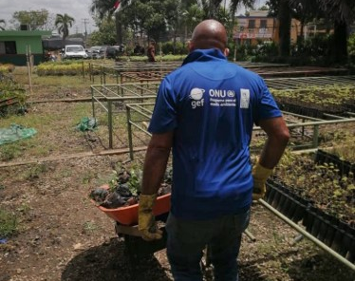




Thank you
UNEP Cartagena Convention Secretariat and Caribbean Environment Programme
(876) 922-9267-9
unep-cartagenaconvention@un.org
www.unep.org/cep
@unep_cep
Photo courtesy of the Cartagena Convention Secretariat

